Slide 1

1994 Adult Census Income Dataset:
Analyzing factors that determine a person’s income based on census data
Group 4: Brian Klovert, Matthew Lombardo, Thusneem Mohamed Ismail

Slide 2
Our data
Our data is a 1994 adult census dataset from Kaggle.com
From this dataset, we will be focusing on the following variables:
Response: Income (above or below $50k a year)
Factors: Education, age, sex, race, marital status, relationship, work class, & occupation

Slide 3
Our questions
What factors impact a persons income (making above or below $50k a year)? If they do, how? Or to what extent?
How do women stack up against men in regard to making over $50k?
What age do you hit your financial peak?
Does attaining higher education result in making more money?
Was the country as diverse in 1994 as we know it now in 2018? Does the race that has the most people reflect in making the most money?
Does it financially make sense to get married?
Does it make sense to go the safe route as opposed to taking a chance on building a business?

Slide 4
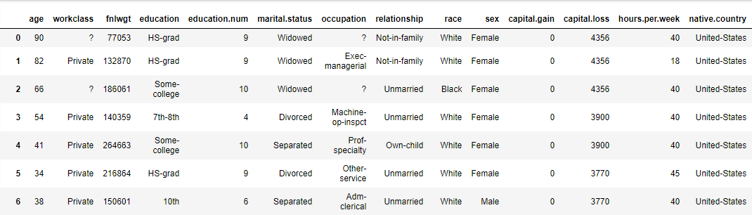
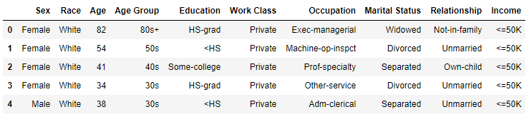
Data clean-up
Removed “?’s” (NA’s) from occupation & work class
Got rid of variables that we aren’t going to use
Renamed and reordered variables
Binned age into age groups (increments of 10 years) for analysis
Combined education levels to more useable and logical levels
Combined marital status (different levels of married to one married category)

Slide 5
Data Analysis

Slide 6
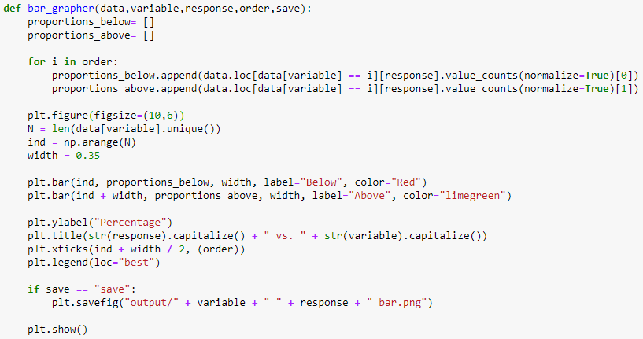

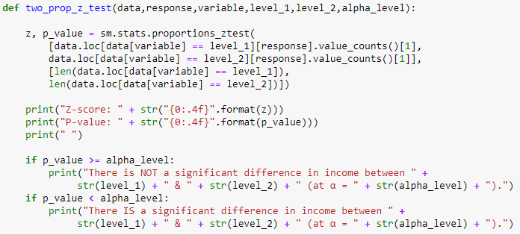

Slide 7
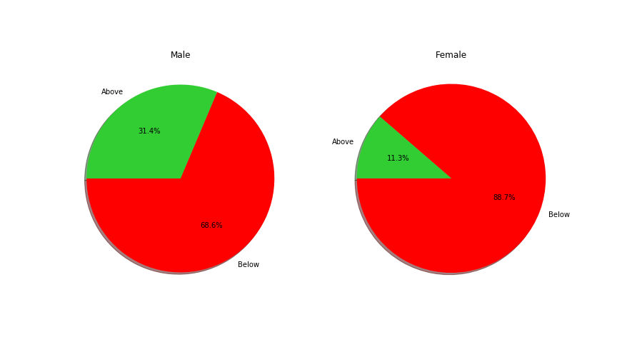
Gender vs. Income

Slide 8
Gender cont.
Z-test:
There is a significant difference in income between Male & Female (P-value = 0.0000)
Conclusion
Males proportionally have higher income than females

Slide 9
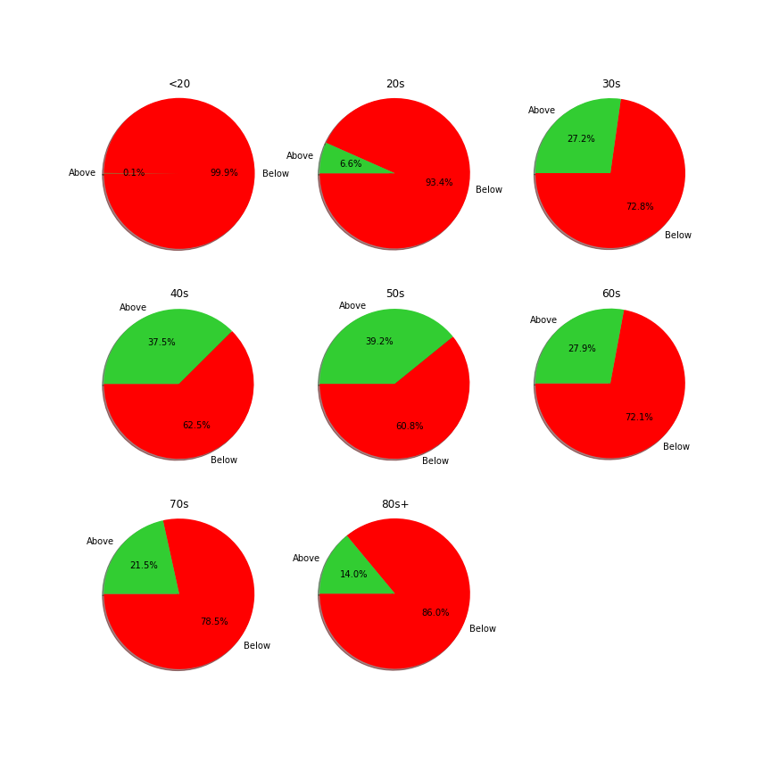
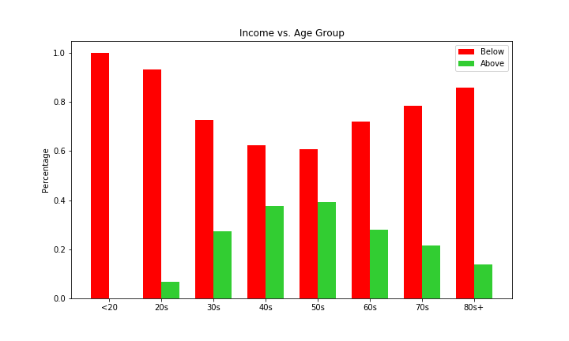
Age vs. Income

Slide 10
Age cont.
Z-tests:
Not a significant difference in income between 40s & 50s (P-value = 0.0859)
There is a significant difference in income between 20s & 80s+ (P-value = 0.0050)
Conclusions:
Age groups with proportionally the highest income: 40s and 50s
Age group with proportionally the lowest income: 20s (not taking into account less than 20)

Slide 11
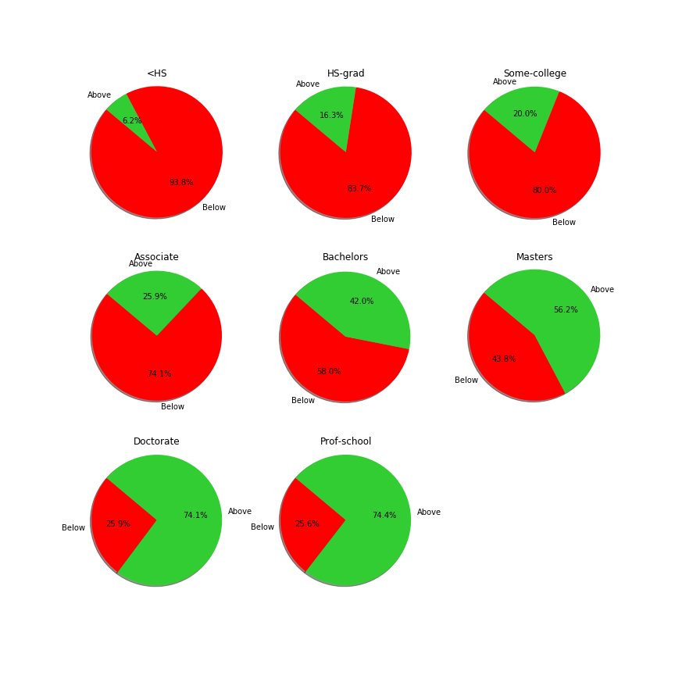
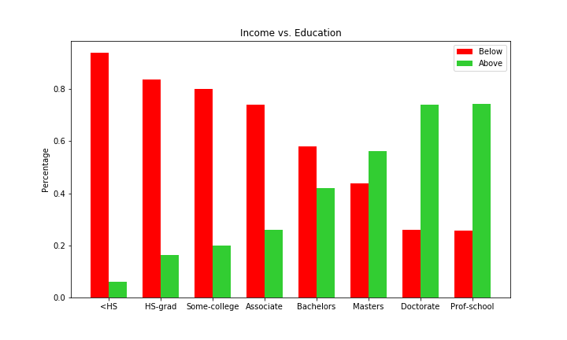
Education vs. Income

Slide 12
Education cont.
Z-tests:
Not a significant difference in income between Doctorate & Professional School grad (P-value = 0.9299)
There is a significant difference in income between dropouts & HS grads (P-value = 0.0000)
There is a significant difference in income between having some college & HS grads (P-value = 0.0000)
There IS a significant difference in income between some college & Associate (P-value = 0.0000)
Conclusions:
Education level with proportionally the highest income: Doctorate & Professional School graduate
Education level with proportionally the lowest income: Dropout

Slide 13
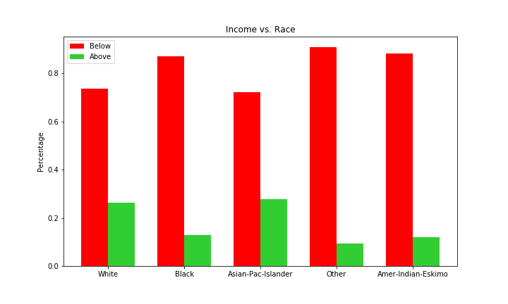
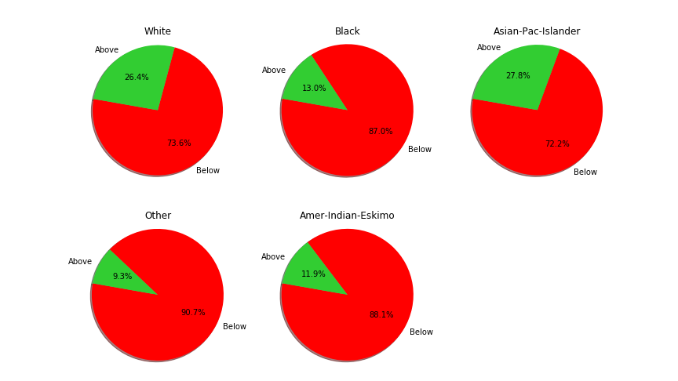
Race vs. Income

Slide 14
Race cont.
Z-test:
Not a significant difference in income between White & Asian-Pac-Islander (P-value = 0.3234)
Not a significant difference in income between Black & Amer-Indian-Eskimo (P- value = 0.5943)
Conclusions:
Race with proportionally the highest income: White & Asian-Pac-Islander
Race with proportionally the lowest income: Black & Amer-Indian-Eskimo

Slide 15
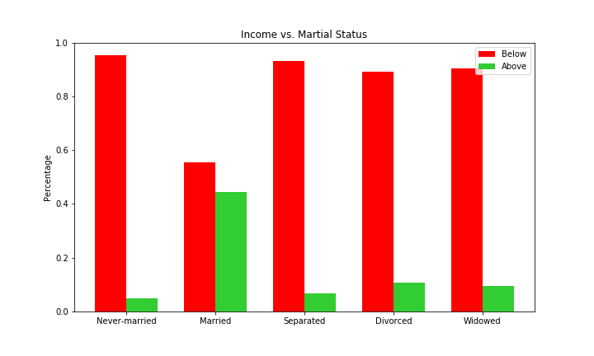
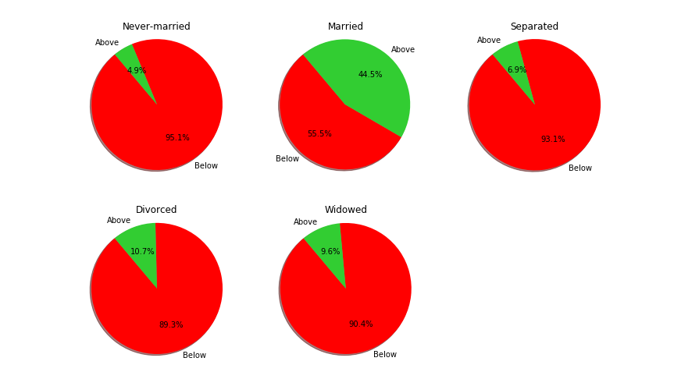
Marital Status vs. Income

Slide 16
Marital Status cont.
Z-tests:
There is a significant difference in income between Never-married & Separated (P-value = 0.0063)
There is a significant difference in income between Divorced & Separated (P-value = 0.0003)
Conclusions
Marital Status with proportionally the highest income: Married
Marital Status with proportionally the lowest income: Never-married

Slide 17
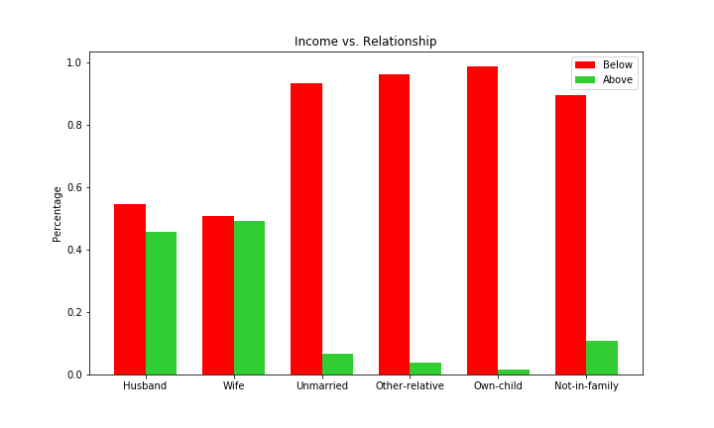
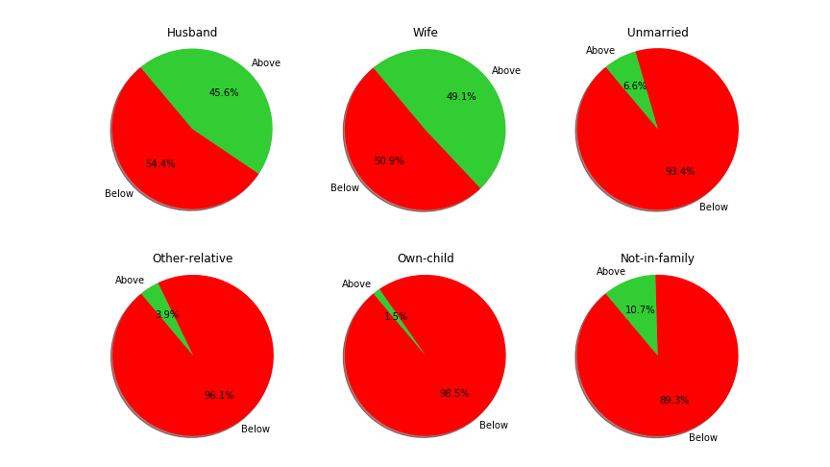
Relationship vs. Income

Slide 18
Relationship cont.
Z-test:
There is a significant difference in income between Husband & Wife (P-value = 0.0103)
Conclusion
Current relationship standing with proportionally the highest income: Wife

Slide 19
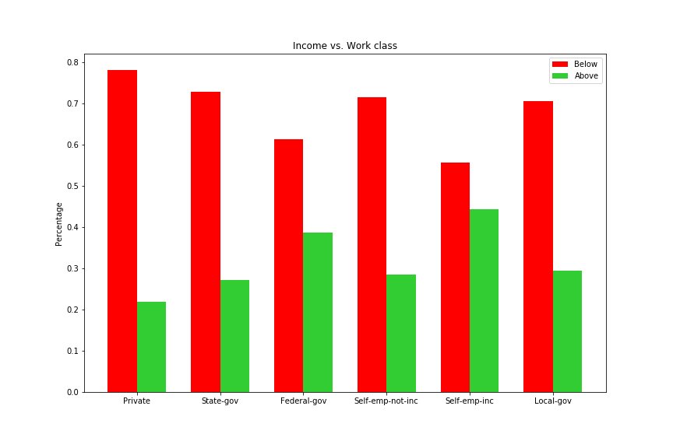
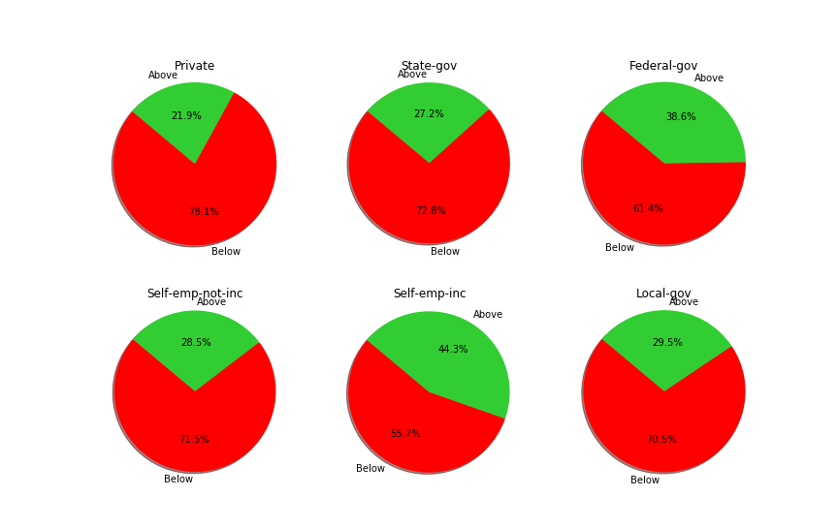
Work Class & Occupation vs. Income

Slide 20
Work Class cont.
Z-test:
There is a significant difference in income between Self-emp-inc & Federal-gov (P-value = 0.0096)
There IS a significant difference in income between Private & State-gov (P-value = 0.0000)
There IS a significant difference in income between Federal-gov & Local-gov (P-value = 0.0000)
Conclusion:
Working class with proportionally the highest income: Self employed (incorporated)
Working class with proportionally the lowest income: Private

Slide 21
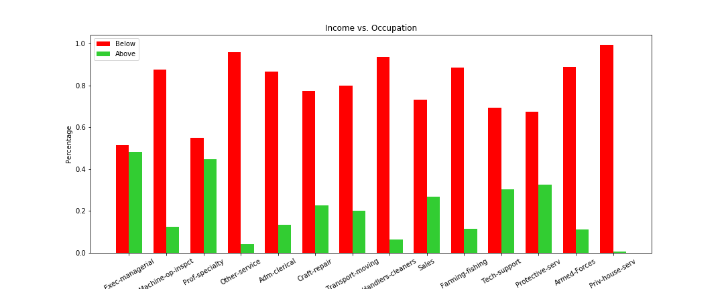
Occupation

Slide 22
Conclusions
Based on this data, we can extrapolate:
A person that would have the highest income would be:
A White or Asian married male in the age range 40-60 with a PHD or graduated from Professional school that is self employed
A person that would have the lowest income would be:
A Black & Amer-Indian-Eskimo never-married female in her 20s or below that dropped out of school and works in the private sector

Slide 23
Conclusions cont.
The Male earns much more than Female
The people with above $50k are more likely to be in the middle of the age distribution
The people with above $50k are more likely to be White or Asian
The people with above $50k are more likely to be married
The people with above $50k salary are more highly educated
Self-employed incorporated people earn much more than self-employed unincorporated people
The people with above $50k are mostly executives

Slide 24
Interesting findings
Age groups:
Bell curve for proportions above $50k
Education:
Proportion of HS grads above $50k is statistically greater than dropouts, proportion of some college above $50k is statistically greater than HS grads, & proportion of Associates above $50k is statistically greater than some college
Doctorate and Professional School have by far the highest proportion of people above $50K at ~74%, higher education is the biggest influencing factor to making above $50k?
Biggest discrepancy in proportions can be seen in education as well, with ~6% above for dropouts and ~74% above for PHD and professional school. There is a 68% difference(which is the biggest seen), education is the most influential factor overall?
Work class:
Self employed (incorporated) has by far the highest proportion above $50k, and self employed (not incorporated) doesn’t have nearly as high of a proportion for above $50k
While there isn’t a significant difference in the proportions above $50k for both state government and local government, the proportion of federal government above $50k is statistically greater (and by a large degree) than state government and local government
Relationship:
Proportion of wives that make above $50k is statistically greater than husbands (where as before the proportion of males that made above $50k was 3x greater than females)
Being married raises the proportions of above $50k earners for both males and females (very drastically for females as discussed above)

